Slide 1
Windows Store and Monetization Windows 10 Developer Workshop

Slide 2

One Store for one Windows
Windows Desktop
Windows Mobile
ONE CORE OS
ONE APP PLATFORM
ONE STORE
Windows 10
Xbox
IoT
HoloLens
Surface Hub

Slide 3
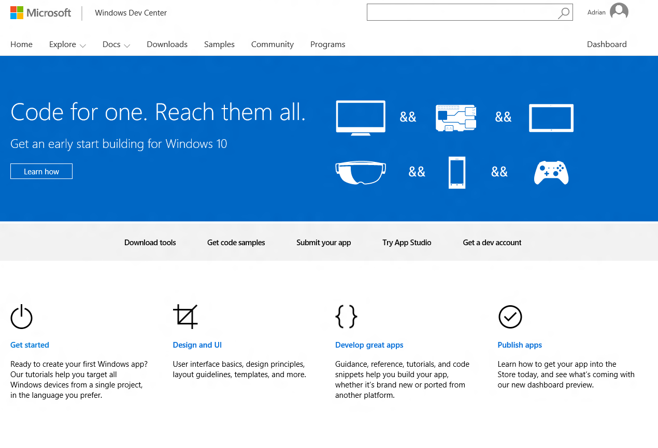
One Dev Center
One destination for supporting all Windows devices
One registration
One app submission
Customer acquisition
Customer engagement
Powerful monetization
Rich analytics
One payout
DEV.WINDOWS.COM

Slide 4
.NET Native compilation
50% faster average startup time
14% less average memory usage

Slide 5
To the Dev Center

Slide 6
The Business Store

Slide 7
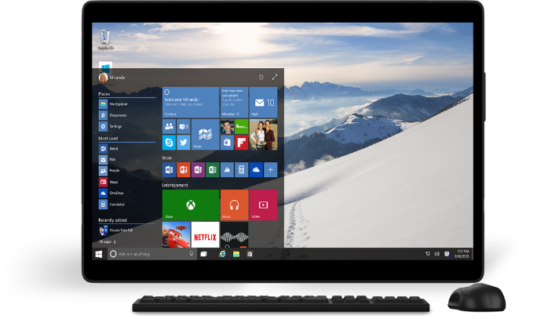
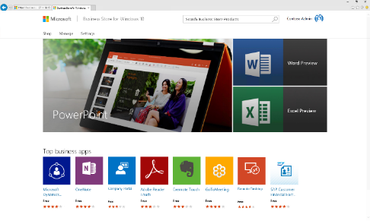
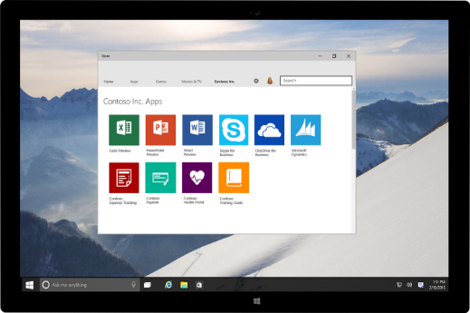
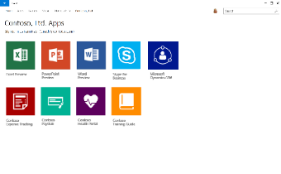
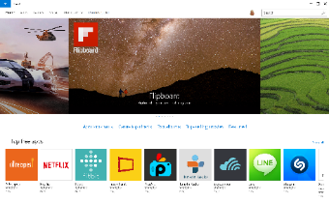

New for Windows 10: Business Store
Extend your reach in volume leveraging the platform and tools you use today
Extend your reach to organization in volume
Reach businesses of all sizes with your existing apps
Submit private/customized apps
No additional overhead
One submission flow, same as consumer
Use Dev Center dashboard to manage and track all apps
Seamless for organizations and end-users
Solution to discover, acquire, manage and distribute apps in volume
Users install across Windows 10 devices
Get Started today
Dev Center opens for Windows 10 app submissions on 7/29

Slide 8
Business Store App Workflow
1
2
ISV logs into Windows Dev Center and submits app
App available in consumer Store
Windows Dev center
1a
IT Developer or ISV may choose to publish to organizations (authorization required)
Business
store
2
App also available in
Business Store for IT Purchaser
2a
App published directly to organization’s inventory
4
Apps deployed to organizational users via method chosen by IT Purchaser
3
Apps acquired by IT Purchaser
added to organization's inventory

